Slide 1

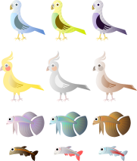
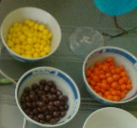




Early Years
Finding things that are similar or different
Being curious and starting to ask questions
Looking for patterns, sorting and grouping
Performing simple tests and using equipment
Working
Scientifically is about…….
Using some scientific words
Observing and measuring
Recording information
Looking closely at things and noticing changes

Slide 2





KS1
Explaining results- saying what we found out
Asking questions
Looking for patterns- sorting and grouping
Performing simple tests, using equipment
Working
Scientifically is about…….
Recording information
Use some
simple scientific words.
Using books, videos, the internet, people and photos to find answers
Observing and measuring

Slide 3


Lower
KS2
Asking relevant questions and using scientific words
Explaining results and drawing conclusions using the evidence
Setting up enquiries, choosing equipment and making sure it is a fair test (with help)
Looking for patterns- identifying and classifying
Working
Scientifically is about…
Choosing how to record information- tables, tally charts, Venn and Carroll diagrams and bar charts
Making predictions and suggesting ways that enquiries could be improved
Recognising when to use other sources of information to find answers
Carefully observing and accurately measuring using a range of equipment

Slide 4


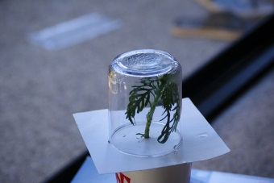


Upper
KS2
Evaluating plans and results and suggesting improvements
Using scientific knowledge to ask questions
Planning different types of enquiry, controlling variables where necessary and ensuring it is a fair test
Use scientific evidence and language to draw conclusions
Working
Scientifically is about …
Using and developing keys to identify and classify living things and materials
Accurately taking measurements using scientific equipment, repeating where necessary.
Recording data and presenting it in different ways
Recognising when to use other sources to answer questions and separating opinion from fact

Slide 5







Is it by identifying and classifying something?
Is it a fair test?
Types of enquiry- what is the best way to answer my question?
Is it by using secondary sources?(books, the internet, video, an expert)?
Is it by observing something over time?
Is it by looking for a pattern?
© Herts for Learning Ltd - 2017

